Slide 1
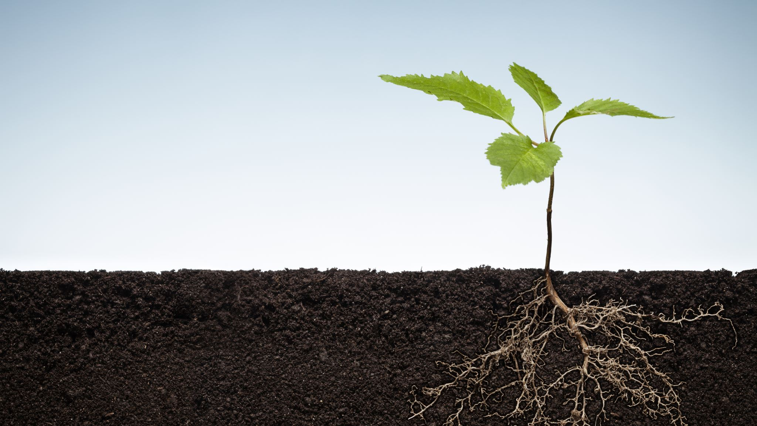
TOMATO LEAF DISEASE DETECTION USING DEEP LEARNING

Slide 2

INTRODUCTION
Nepal: known for its agriculture production and dependence.
Nepal's agriculture sector
Two-third of the population reliant
contributes 23.13% of nation’s GDP.
Full potential of the crop
only if diseases that affect the crop are kept under control.

Slide 3
INTRODUCTION
Hence, Disease Detection
Necessary, important for good crops
Disease detection with human observation
Time consuming
Experience, Knowledge necessary
Payment may be required to professionals
Disease detection with Automated system
Much faster
No payment required
No prior training

Slide 4
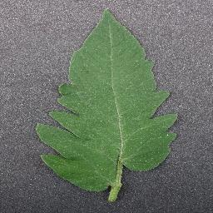
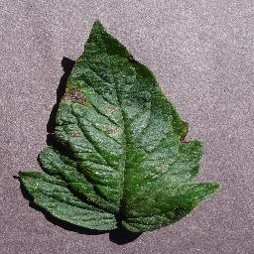
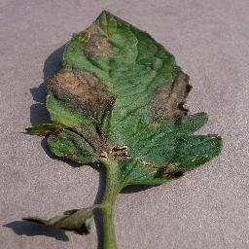
Overview of Tomato Plant Disease
Healthy Leaf
Early Blight
Late Blight

Slide 5
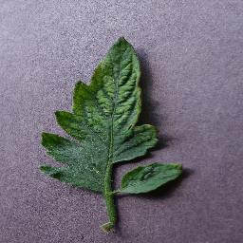
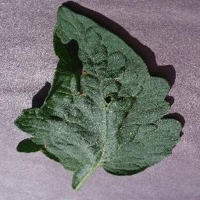
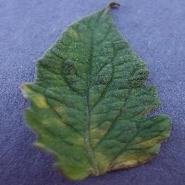
Overview of Tomato Plant Disease
Tomato Mosaic virus
Target Spot
Leaf Mold

Slide 6
Problem Statement
Leaf diseases
Affect leaf
Affect photosynthesis and other activities
Can cause crop damage
Spreads wildly if unchecked
Quick detection necessary
Present research on disease detection
More Focused on transfer learning

Slide 7
Objective
CNN model
Suggest and Train
Compare with existing transfer learning models
Web App
Integrate model
Detect disease
Help Relevant parties

Slide 8
Scope and Applications
Quick detection of disease
Help Farmers
Help Relevant parties without proper training
Suggest
Possible causes of disease
Remedies of the disease

Slide 9
LITERATURE REVIEW
S.N | TITLE | DATE | AUTHORS | TECHNIQUE | Accuracy
1 | Potato Leaf Diseases Detection and Classification System | February, 2016 | P. Badar et. al. | K Means Clustering and Back Propagation Neural network | 92%
2 | Wheat Disease Recognition through One-shot Learning using Fields Images | April , 2021 | Hamza Mukhtar et. al. | one shot network with mobilenetv3 | 92%
3. | Tomato Leaf Disease Detection using Convolutional Neural Network | August, 2018 | Prajwala TM et.al. | Proposes modification of LeNet | 94-95%

Slide 10
LITERATURE REVIEW
S.N | TITLE | DATE | AUTHORS | TECHNIQUE | Accuracy
4 | Visual Tea Leaf Disease Recognition Using a Convolutional Neural Network Model | March, 2019 | J Chen et. al. | LeafNet algorithm | 90%
5 | Detection of Potato Diseases Using Image Segmentation and Multiclass Support Vector Machine | 2017 | Monzurul Islam et. Al | segmentation approach and utilization of support vector machine | 95%
6 | Potato Leaf Diseases Detection Using Deep Learning | 2020 | Divyansh Tiwari et.al. | Transfer Learning + Linear regression | 97%

Slide 11
LITERATURE REVIEW
S.N | TITLE | DATE | AUTHORS | TECHNIQUE | Accuracy
7 | Image Recognition of Grape Downy Mildew and Grape Powdery Mildew Based on Support Vector Machine | 2012 | Guanlin Li et.al. | Support Vector Machine and k means clustering | 90%
8 | Deep Learning for Image-Based Cassava Disease Detection | October, 2017 | Anand Ramacharan et. Al. | Multilple Transfer learning | 93%
9. | Disease Detection on the Plant Leaves by Deep Learning | 2019 | P Goncharov et.al. | Siamese Networks for Learning Data Embeddings | 90%

Slide 12
REQUIREMENT ANALYSIS
SOFTWARE REQUIREMENTS
HARDWARE REQUIREMENTS
FUNCTIONAL REQUIREMENTS
NON-FUNCTIONAL REUIREMENTS

Slide 13
SOFTWARE REQUIREMENTS
Python
Tensorflow
Jupyter Notebook
Visual Studio Code
Google Colaboratory
Github
Flask
Google Chrome

Slide 14
HARDWARE REQUIREMENTS
Desktop with connection to internet to run the web app.
Computer with Nvidia GPU to train model.

Slide 15
FUNCTIONAL REQUIREMENTS
Upload an image
Detect the disease
Show possible causes and its remedies
Show possible error if condition not met

Slide 16
NON-FUNCTIONAL REQUIREMENTS
Accessibility
Reliability
Maintainability
Performance

Slide 17
FEASIBILITY ANALYSIS
Economic Feasibility
Technical Feasibility
Operational Feasibility
Scheduling Feasibility

Slide 18
METHODOLOGY
Incremental SDLC
System Design and Architecture
Steps Involved in Training and Creation of
Model

Slide 19
INCREMENTAL SDLC
fig: Incremental Developmental Model

Slide 20
SYSTEM DESIGN AND ARCHITECTURE
fig: Black Box Diagram of Tomato Leaf Disease Detection System

Slide 21
SYSTEM DESIGN AND ARCHITECTURE
fig: Block Diagram of Tomato Leaf Disease Detection System

Slide 22
SYSTEM DESIGN AND ARCHITECTURE
fig: Use Case diagram of Tomato Leaf Disease Detection System

Slide 23
SYSTEM DESIGN AND ARCHITECTURE
fig: Sequence Diagram of Tomato Leaf
Disease Detection System

Slide 24
STEPS INVOLVED IN TRAINING AND CREATION OF MODEL
Data Acquisition
Data Pre-Processing
Classification
Experimental Settings
Optimizer and loss Functions
Evaluation Metrics for Disease detection

Slide 25
Data Acquisition
Plant Village Dataset
Freely Available on the internet
RGB format
256 * 256
Jpg format
10 different classes, 14303 images used
Dataset Breakdown

Slide 26
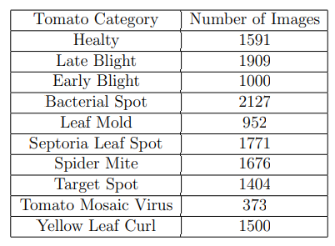

Slide 27
Data Preprocessing
Resize
256*256 for uniformity
Rescale
1./255
pixels are treated in the same manner (0,1)
Data Augmentation
Random horizontal and vertical flip
Random rotation of each image
improve performance and outcomes

Slide 28
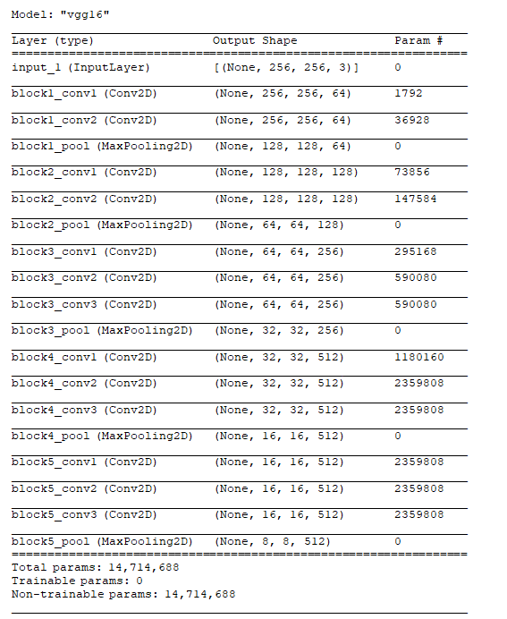
Classification
Vgg16 architecture

Slide 29
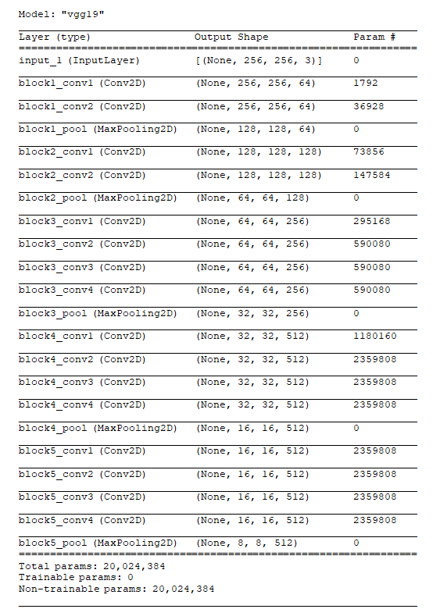
Vgg 19 architecture

Slide 30
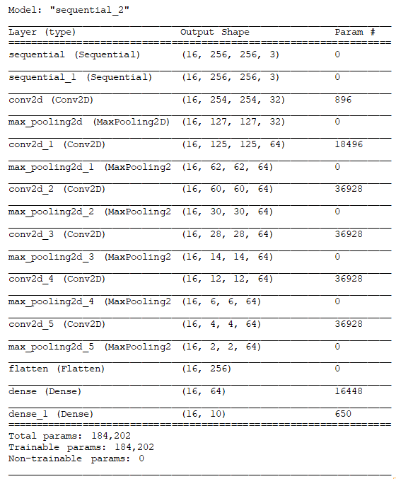
Suggested model
Six blocks, one block
Convolutional layer
Kernel size(3,3)
zero padded in order to preserve the size of the image
activation layer
activation function RELU
Introduce non linearity
max pooling layer.
Pool size of (2,2)
Followed by a flatten layer.

Slide 31
Suggested model
Convolutional and pooling layers
feature extraction
Two Fully connected layers
classification.
64 neurons and relu activation function in penultimate
10 in the last with soft max activation function

Slide 32
Experimental Settings
Keras
A neural network API written in Python, was for the model implementation.
Tensorflow-gpu version 2.6.0
Dataset
randomly divided into train, test and validation sets with ratio of 0.8: 0.1: 0.1.
Batch size :32
100 epochs.
Nvidia 3080 TI GPU with 11gb memory
RAM of 32 GB and Intel i7 processor
python version 3.9.7,
cudnn version 8.2.1 and cuda-toolkit version of 11.3.1.

Slide 33
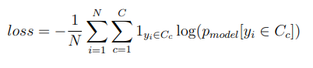
Optimizer & Loss Function
Adam optimizer
Learning rate: 0.
Extension to stochastic gradient descent
Broader adoption for deep learning applications
Loss function
sparse categorical cross entropy

Slide 34
Evaluation Metrics
Precision
precise/accurate a model is out of those predicted positive
how many of them are actual positive
Recall:
how many of the Actual Positives our model capture through labeling it as Positive (True Positive).
F1 Score:
Function of Precision and Recall.

Slide 35
RESULT AND ANALYSIS
For VGG16
For VGG19
For XCEPTION
For Model Trained from Scratch

Slide 36
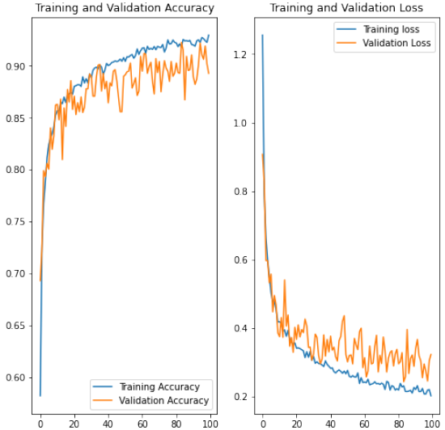
FOR VGG16
fig: Accuracy and Loss Curve of VGG16

Slide 37
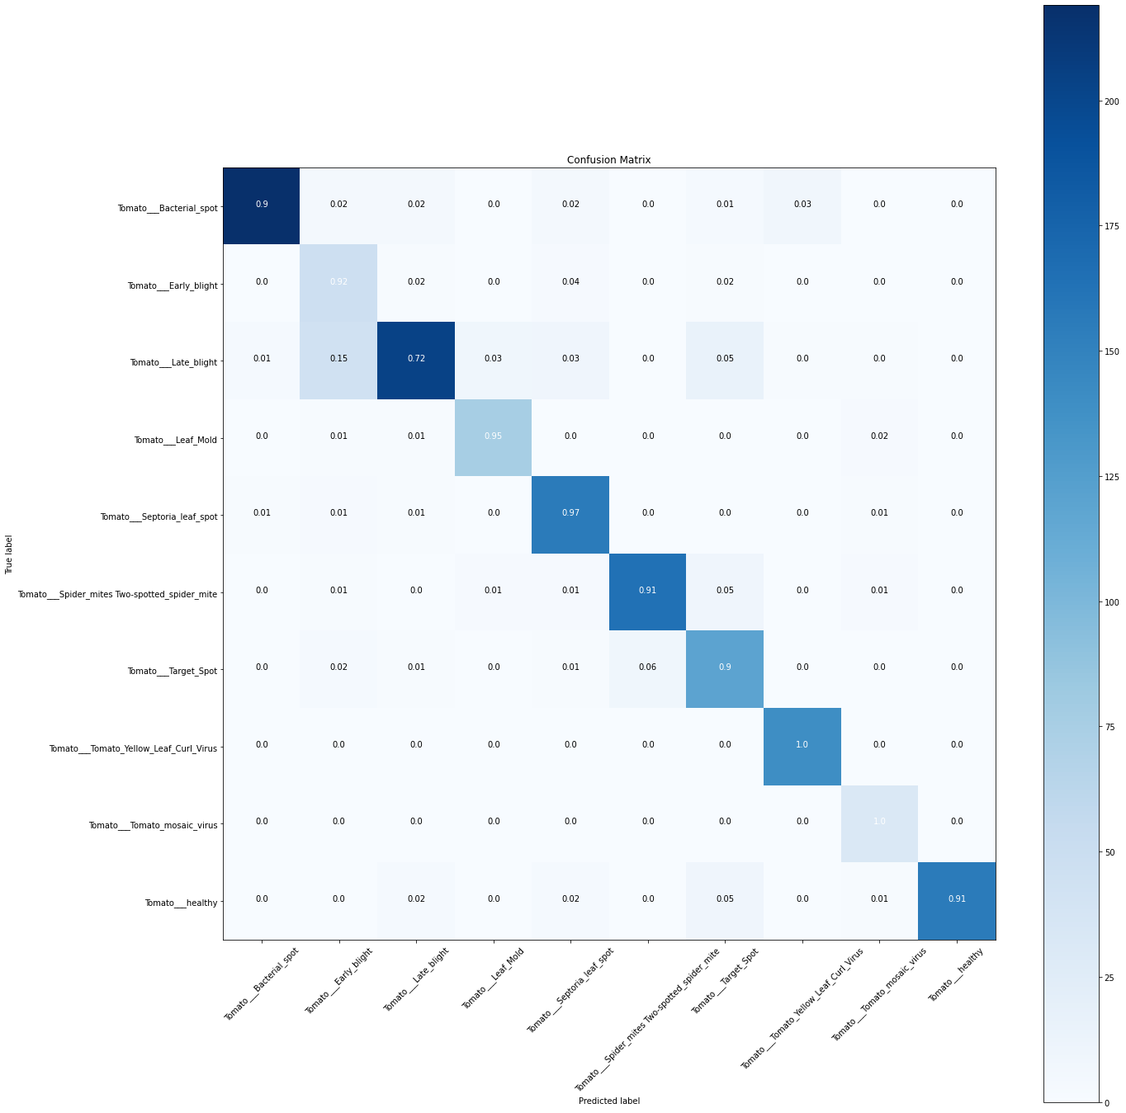
FOR VGG16
fig: Confusion matrix of VGG16 Model

Slide 38
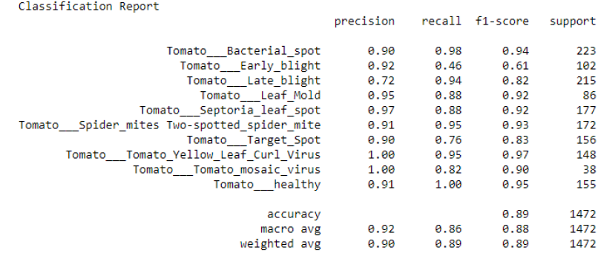
FOR VGG16
fig: Classification metrics of VGG16 model

Slide 39
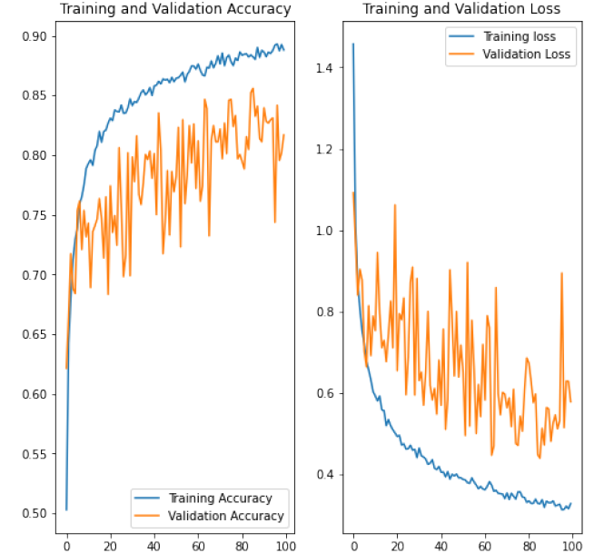
FOR VGG19
fig: Accuracy and Loss Curve of VGG19

Slide 40
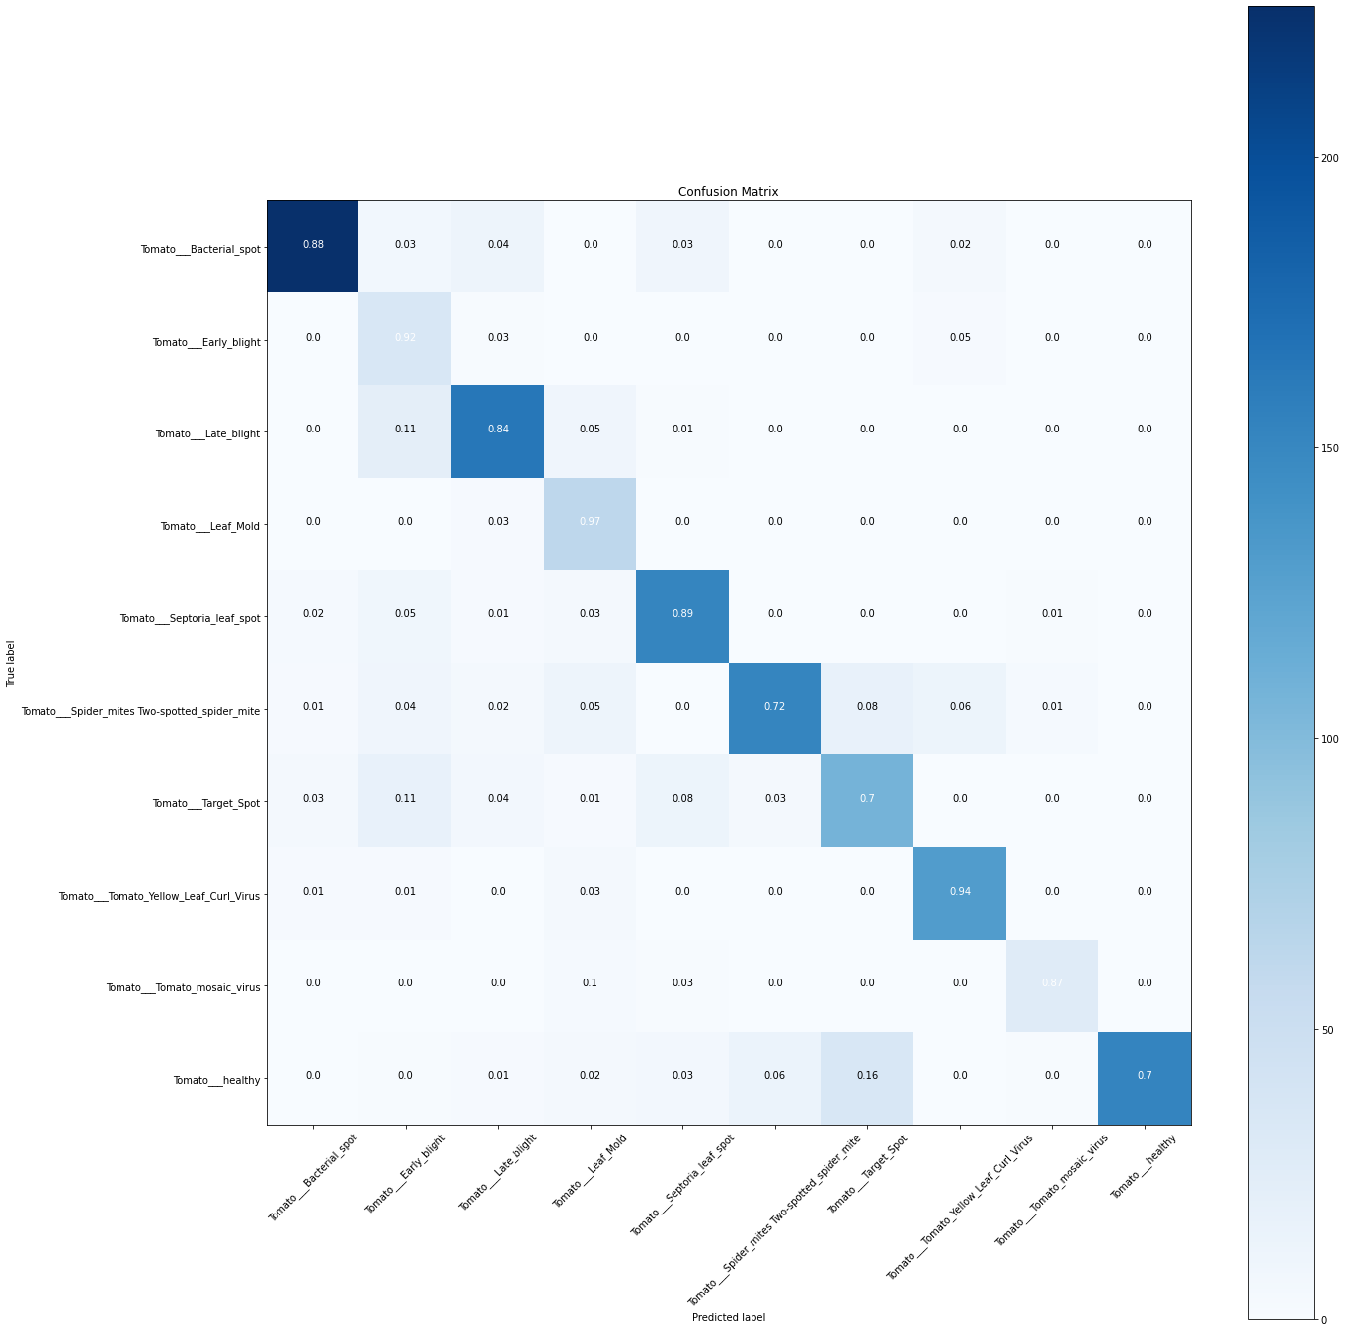
FOR VGG19
fig: Confusion matrix of VGG19 Model

Slide 41
FOR VGG19
fig: Classification metrics of VGG19 model

Slide 42
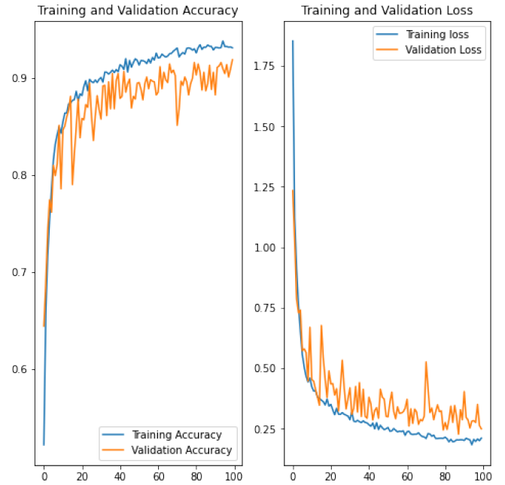
FOR XCEPTION
fig: Accuracy and Loss Curve of Xception Model

Slide 43
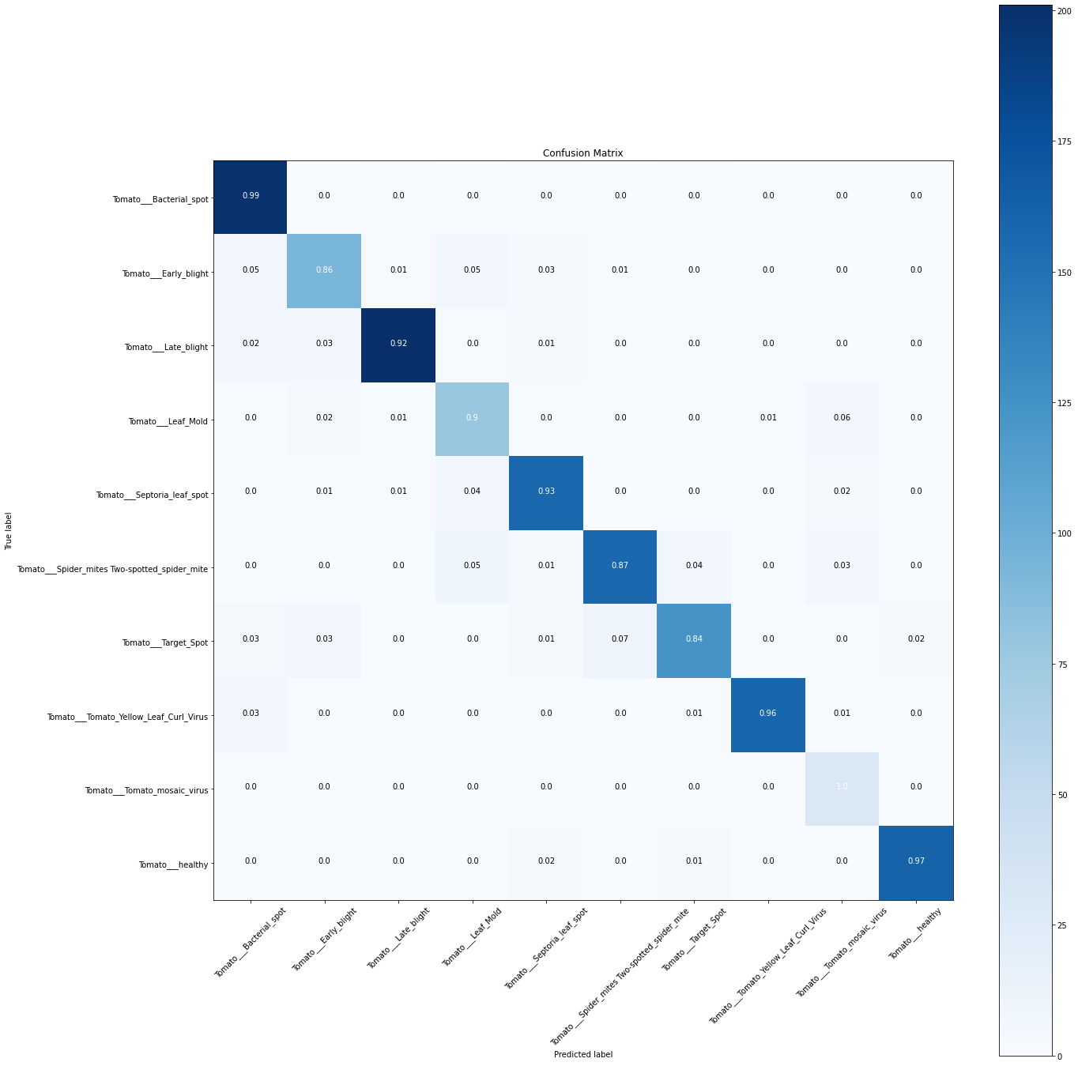
FOR XCEPTION
fig: Confusion matrix of Xception Model

Slide 44
FOR XCEPTION
fig: Classification metrics of Xception model

Slide 45
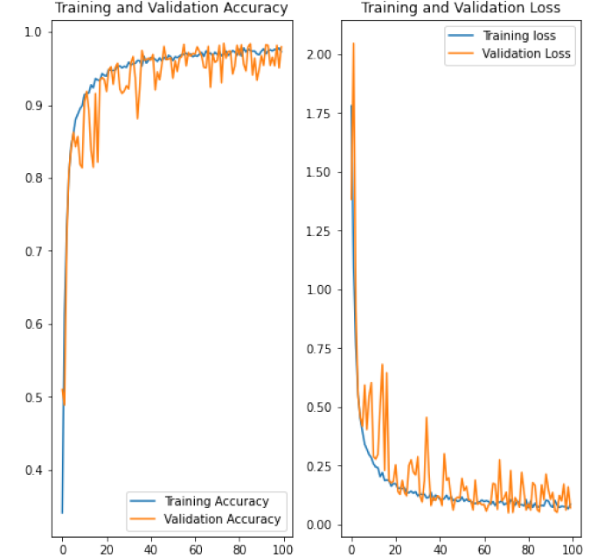
For Model Trained from Scratch
fig: Accuracy and Loss Curve of Model Trained from Scratch

Slide 46
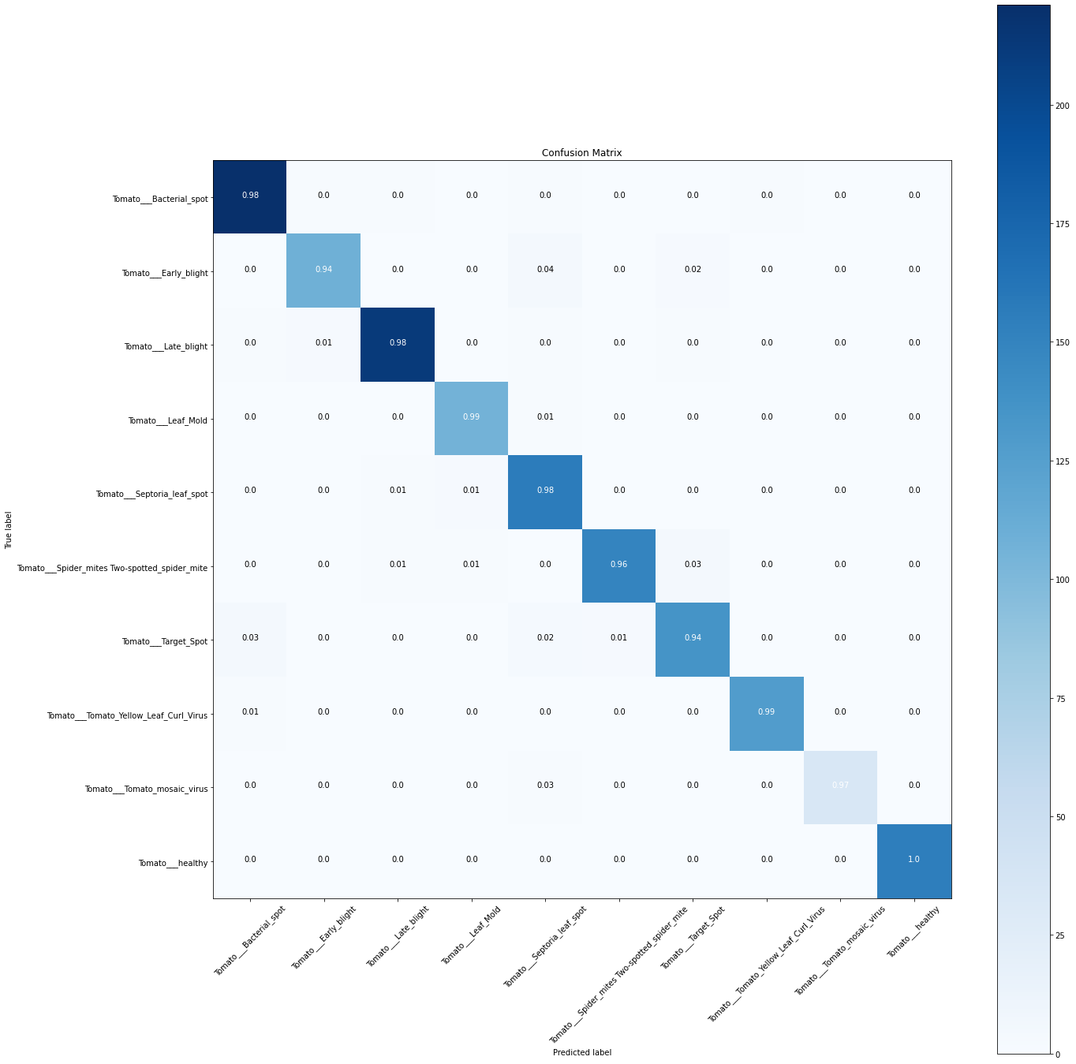
For Model Trained from Scratch
fig: Confusion matrix of Model Trained
from Scratch

Slide 47
For Model Trained from Scratch
fig: Classification metrics of Model Trained from Scratch

Slide 48
CONCLUSION
Hence, with the supervision of the project supervisor and proper coordination among all the team members, we successfully developed a CNN model and implemented it as web application. Using this web application, user can predict the disease of tomato plant with high speed and accuracy.

Slide 49
Limitations and Future Enhancement
Same approach can be applied to create a mobile app.
Model can expanded to further include more diseases.
Model can expanded to included more plants.
App can be created with nepali or other languages which are suitable for farmers.
Methods like Siamese networks can be used to train the networks with less number of dataset images
Similarly we can even develop such model in which we upload a video and model can predict different diseases of the leaves of video.

Slide 50
BIBLIOGRAPHY
Mohit Agarwal, Abhishek Singh, Siddhartha Arjaria, Amit Sinha, and Suneet Gupta. Toled: Tomato leaf disease detection using convolution neural network. Procedia Computer Science, 167:293–301, 2020.
RK Arora and SM Paul Khurana. Major fungal and bacterial diseases of potato and their management. In Fruit and vegetable diseases, pages 189–231. Springer, 2004.
Girish Athanikar and Priti Badar. Potato leaf diseases detection and classification system. International Journal of Computer Science and Mobile Computing, 5(2):76–88, 2016.
Pierre Barr´e, Ben C St¨over, Kai F M¨uller, and Volker Steinhage. Leafnet: A computer vision system for automatic plant species identification. Ecological Informatics, 40:50–56, 2017.

Slide 51
BIBLIOGRAPHY
Jing Chen, Qi Liu, and Lingwang Gao. Visual tea leaf disease recognitionusing a convolutional neural network model. Symmetry, 11(3):343, 2019.
Fran，cois Chollet. Xception: Deep learning with depthwise separable convolutions. In Proceedings of the IEEE conference on computer vision and pattern recognition, pages 1251–1258, 2017.
Pavel Goncharov, Alexander Uzhinskiy, Gennady Ososkov, Andrey Nechaevskiy, and Julia Zudikhina. Deep siamese networks for plant disease detection. In EPJ web of conferences, volume 226, page 03010. EDP Sciences, 2020.

Slide 52
OUTCOME OF THE PROJECT
fig: Homepage

Slide 53
OUTCOME OF THE PROJECT
fig: Info About Diseases

Slide 54
OUTCOME OF THE PROJECT
fig: Upload an image

Slide 55
OUTCOME OF THE PROJECT
fig: Diseases Result

